Slide 1

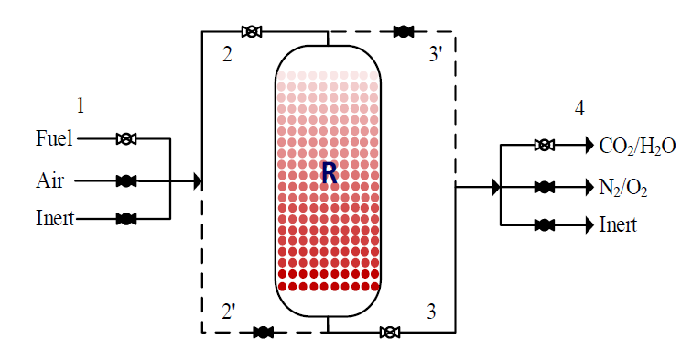
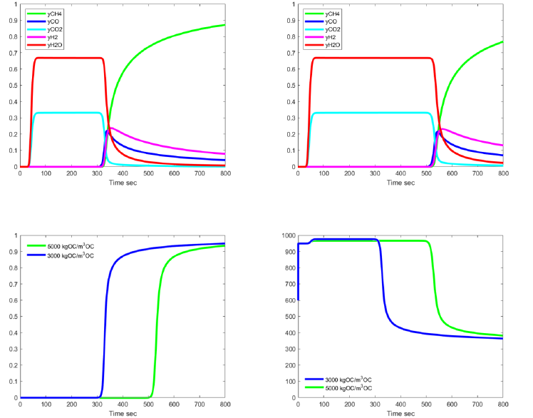
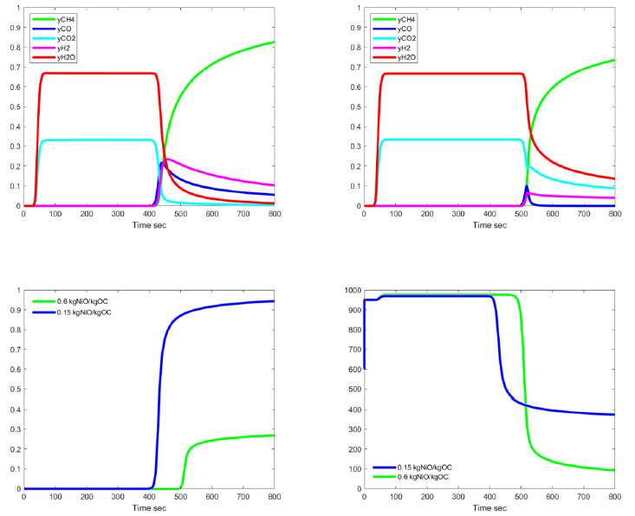
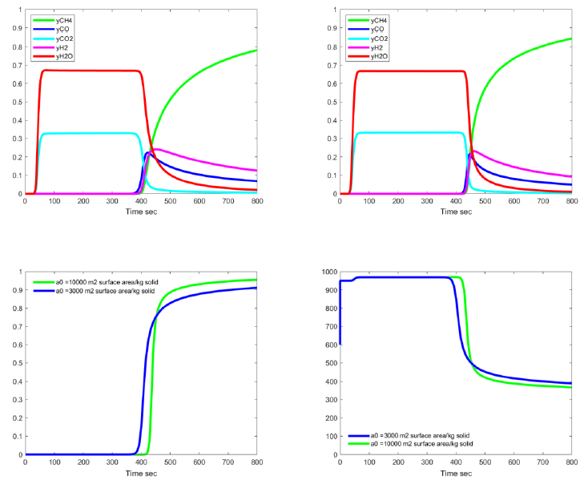
Modeling and Parametric Study for A Fixed-Bed Methane Chemical Looping Combustion Reactor Yi-Huan Chaio(趙奕寰), Hsuan Chang(張煖)* Dept. of Chemical and Materials Engineering, Tamkang University E-mail: nhchang@mail.tku.edu.tw MOST 108-2221-E-032-027
2019 TwIChE Annual Meeting
前言
化學循環燃燒(Chemical Looping Comubustion, CLC)是碳捕捉技術之一，可獲得高濃度二氧化碳。
使用交替操作之固定床CLC可操作於高壓，且免除固體循環流動之操作困難。
本研究在Matlab平台建立一個固定床CLC之一維非均相動態數學模式，模擬甲烷燃燒步驟之性能，並進行氧載體參數影響分析。
Effects of Oxygen Carrier Density
Gas mole fraction at reactor exit
Fixed bed CLC with periodic oxidation and reduction operations
Effects of Oxygen Carrier Initial Concentration
OC conversion at reactor exit
Gas temperature at reactor exit
Effects of Oxygen Carrier Specific Surface Area
Gas mole fraction at reactor exit
Gas mole fraction at reactor exit
OC conversion at reactor exit
Gas temperature at reactor exit
OC conversion at reactor exit
Gas temperature at reactor exit
結論
氧載體密度愈高，達到甲烷反應物貫穿的時間愈長。
氧載體初始氧化態濃度(kgNiO/kgOC)愈高，達到甲烷反應物貫穿的時間愈長，反應器溫度因水氣轉移反應之發生而降得過低，使得氧載體之轉化率無法提高。
固體比表面積之改變對反應器出口之濃度分佈、氧載體轉化率與溫度分佈影響均不顯著。

